Slide 1
Explore Data Geographically

Slide 2
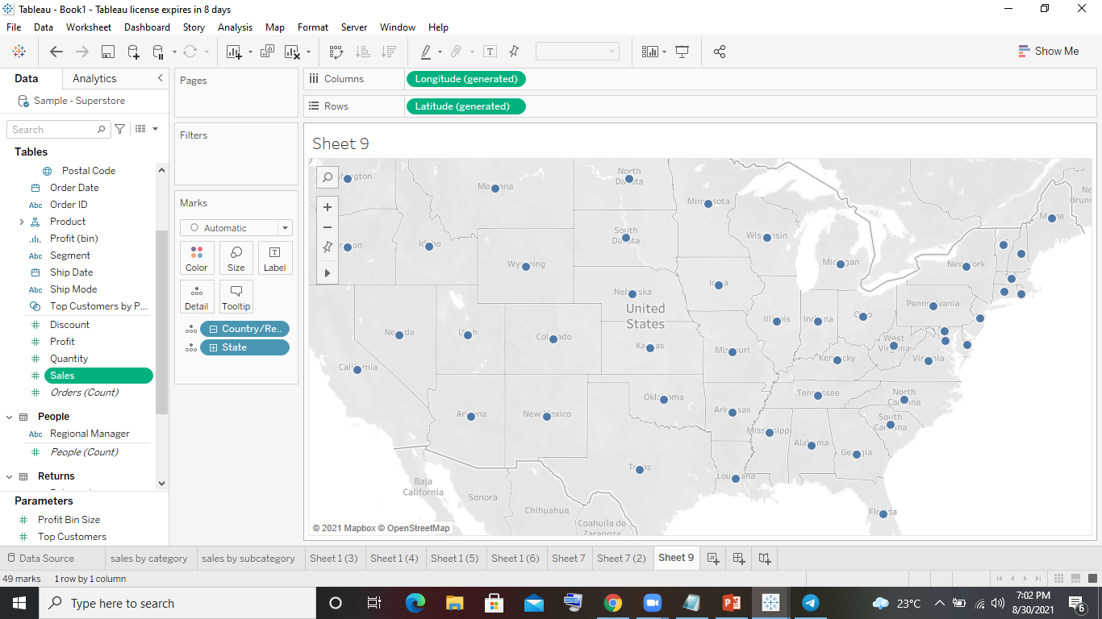
1. Create a Map view to represent all the states with country.

Slide 3
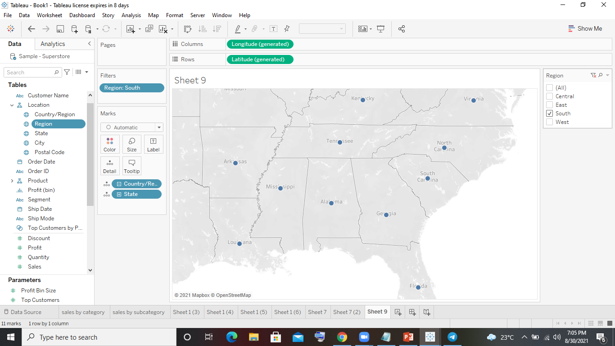
2. Check your map for south region.

Slide 4
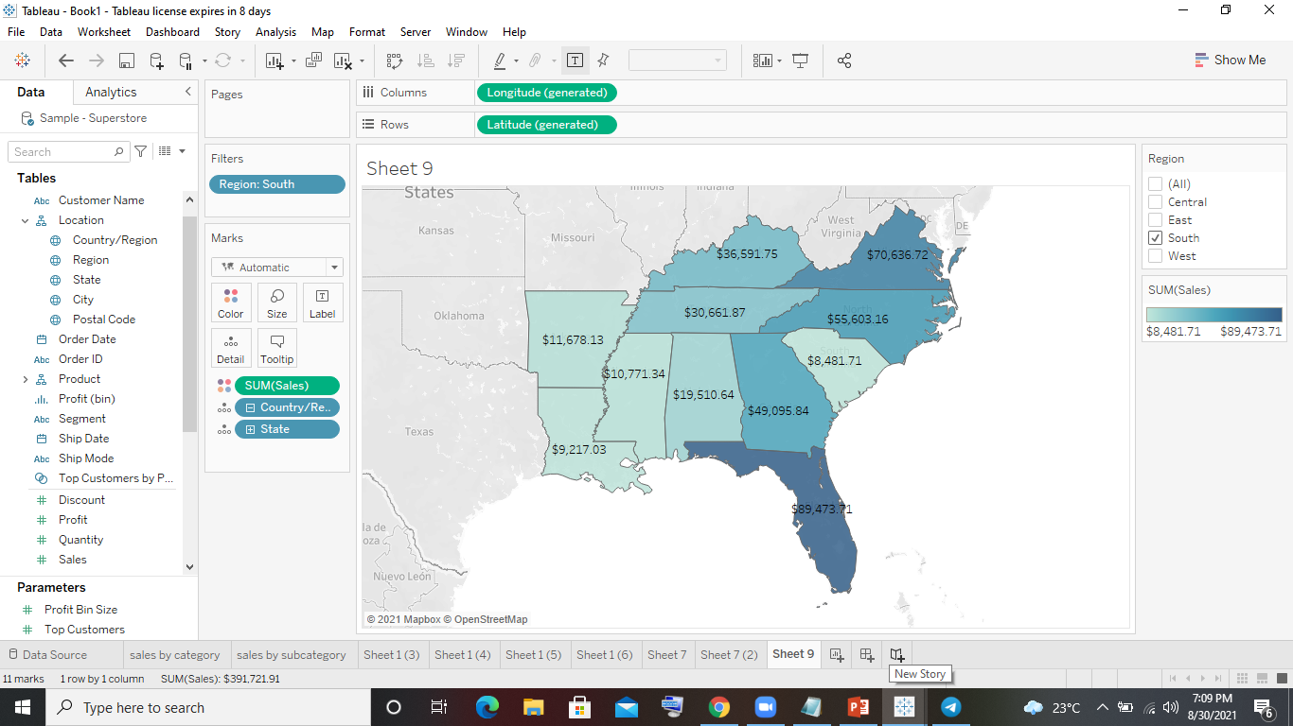
4. Check the sales for south region.

Slide 5
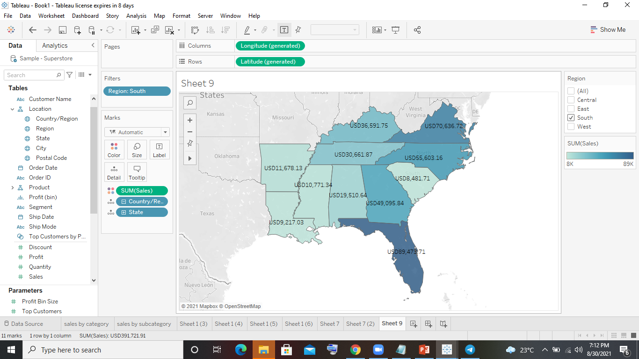
5. Find the state that has highest sales.
Florida has highest sales with 89,473
6. Represent your sales in USD.

Slide 6
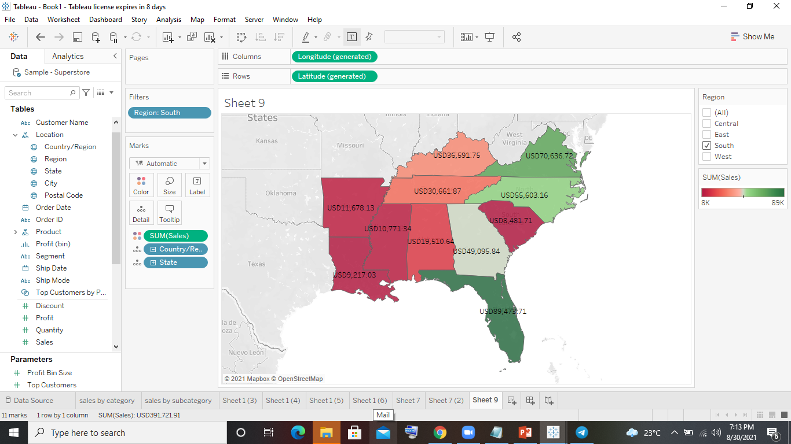
7. Edit color for you map.

Slide 7
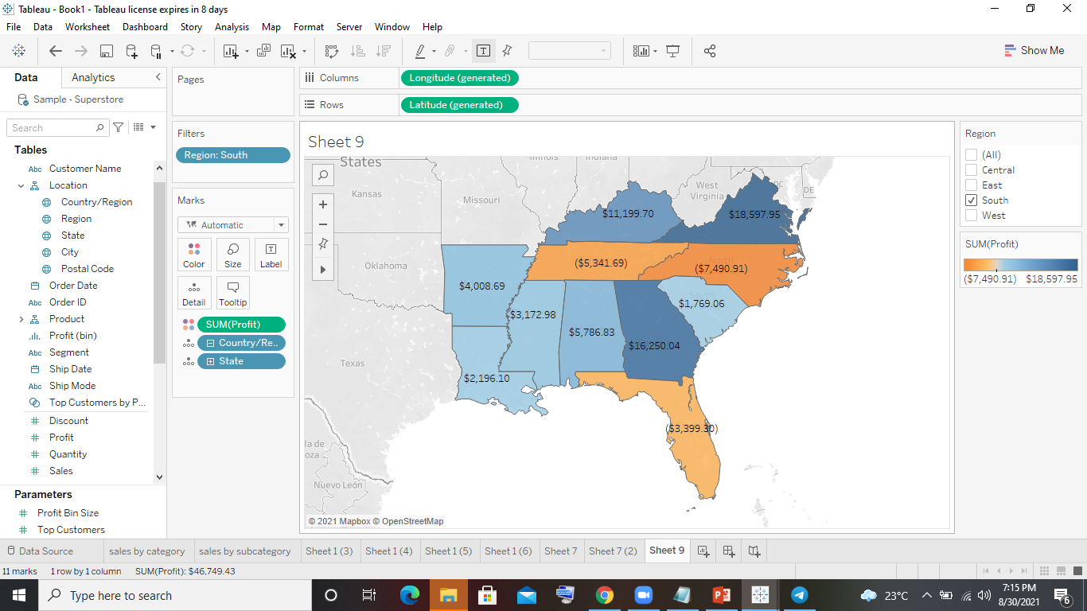
8. Show profit for all the states in your map in south region.

Slide 8
9. Find out the name of some states having negative profit.
There are three states with negative profit
Florida, North Caroline and Tennessee
10.Note down the name of the states having lowest profit and highest profit.
Lowest profit South Caroline with 1769
Highest Profit Virginia with 18,597

